Slide 1
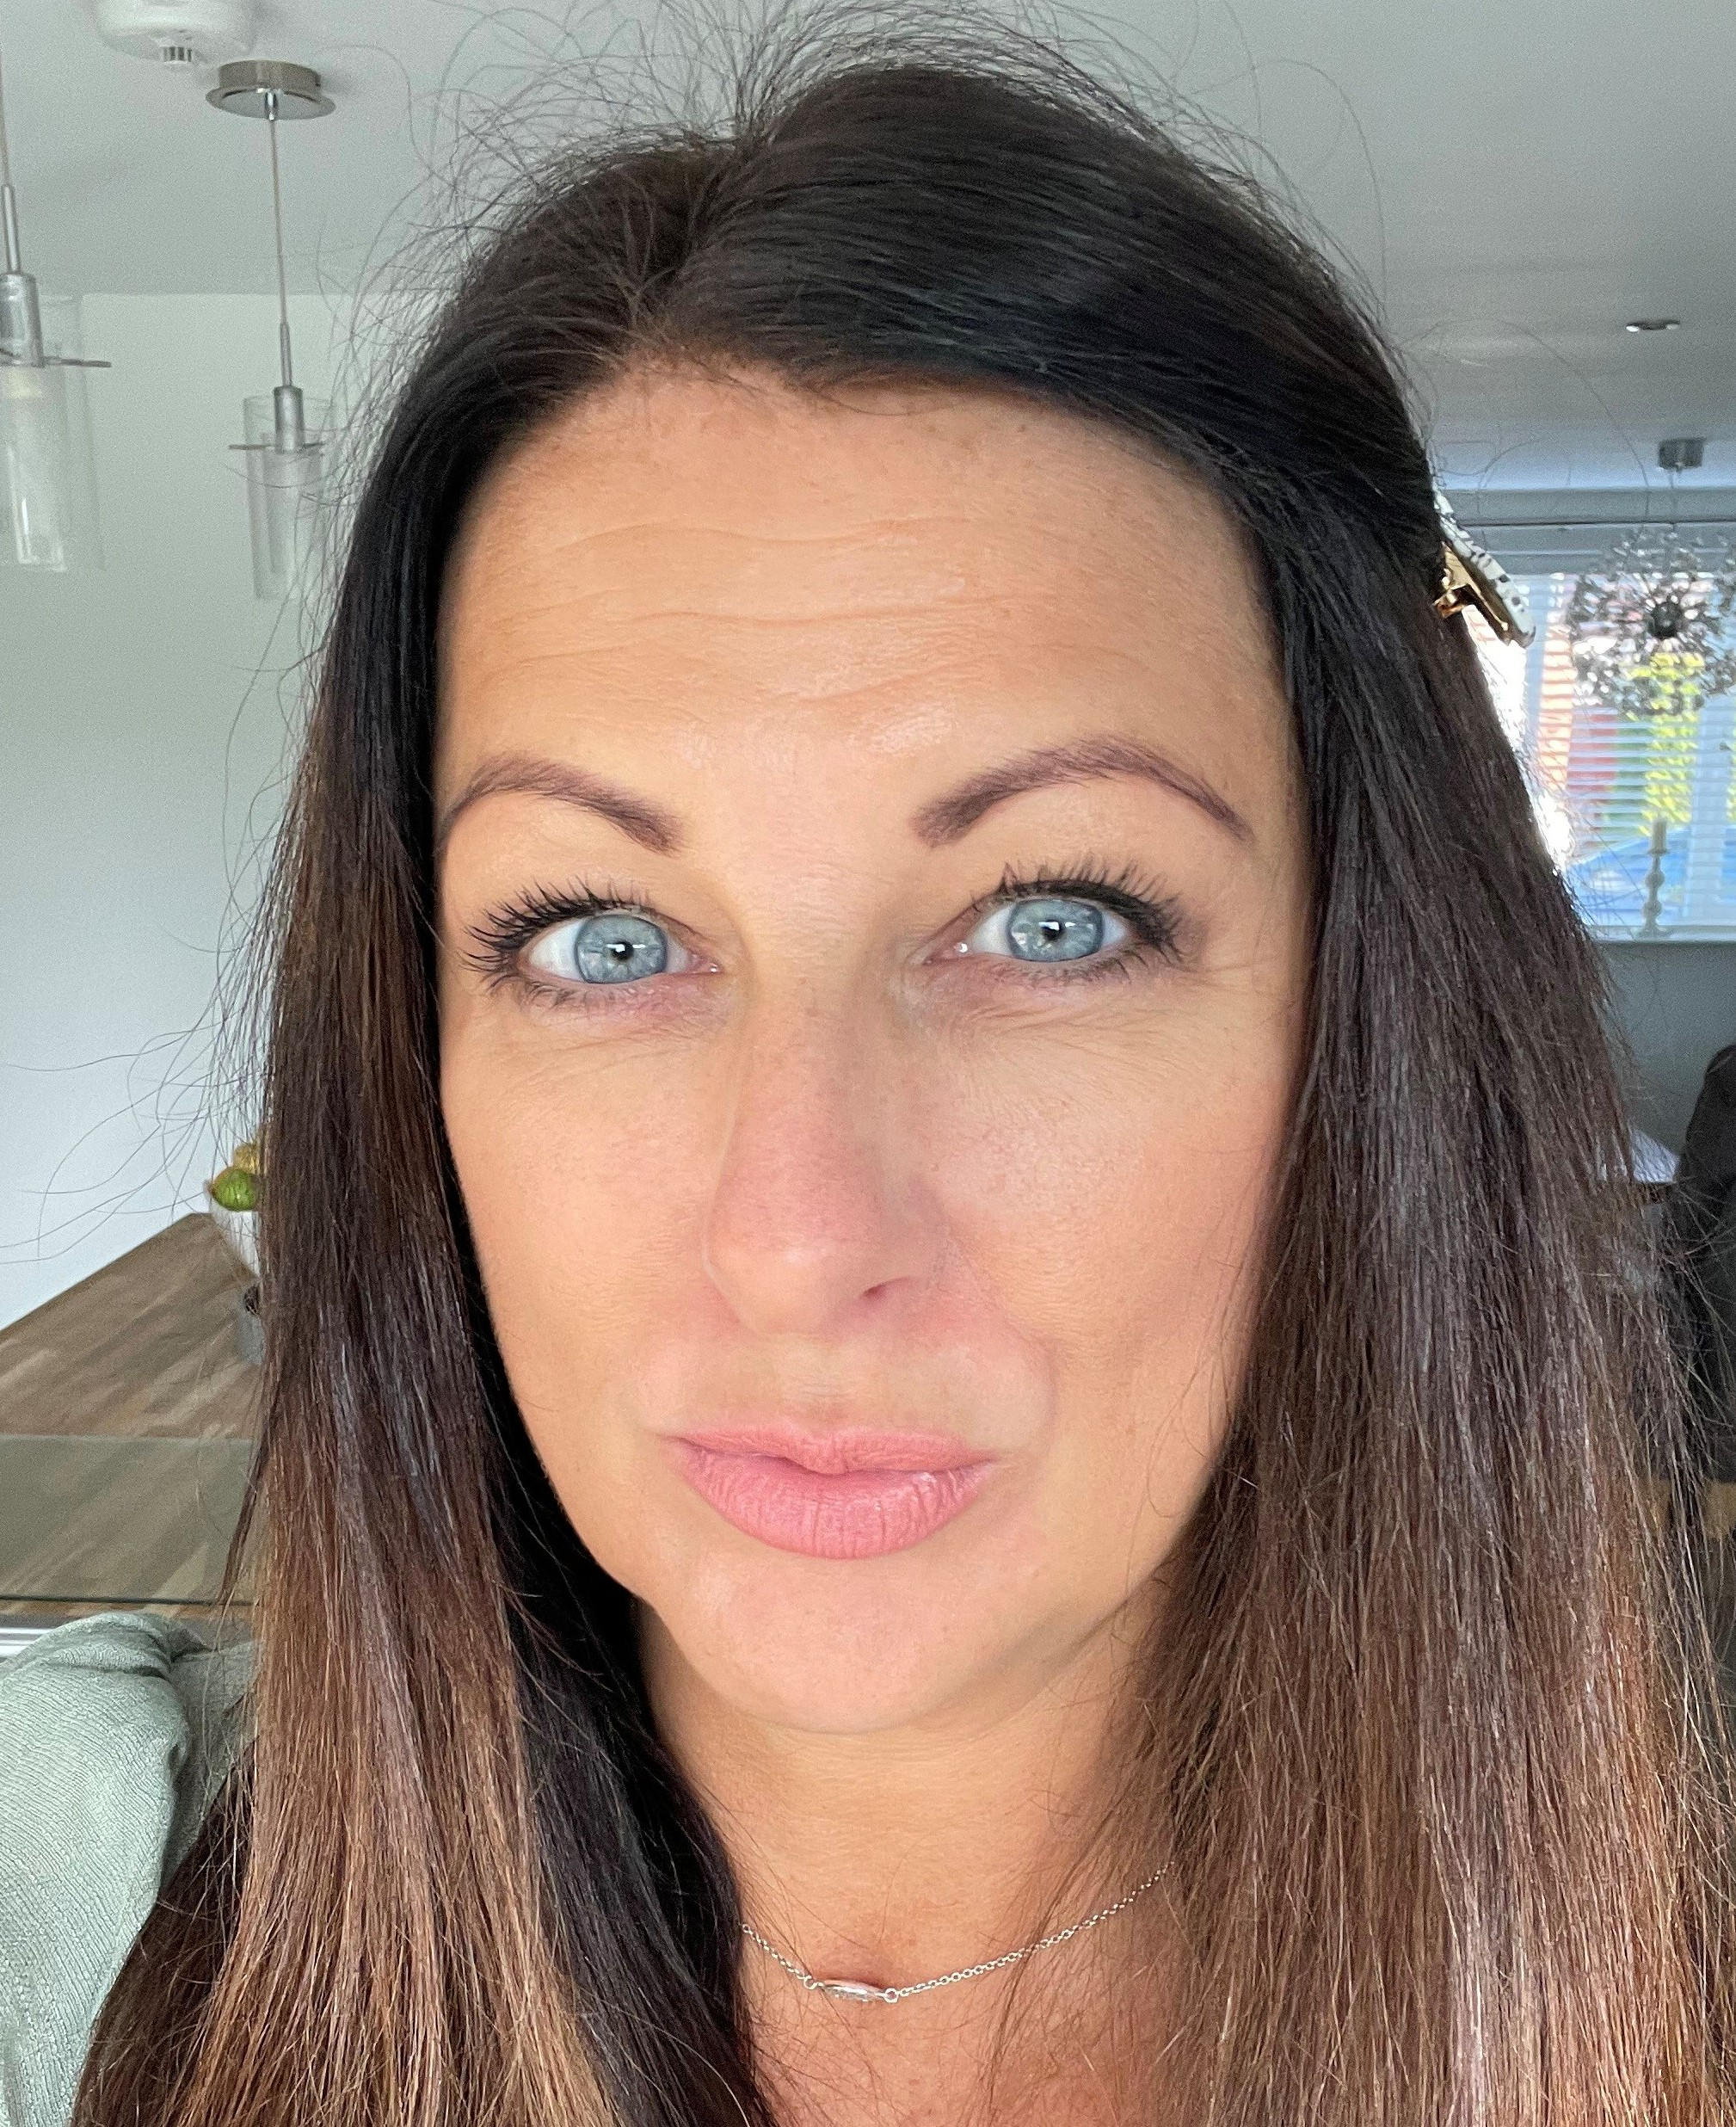
Local Academy Committee |  |  |  |  |  | What we do
LAC Chair | Vice Chair / Parent Member (LL) | Staff Member | Parent Member (MM) | LAC Member | Foundation Member
Rachel Yemm | Claire Shardlow | Linda Norcross | Amanda Haymes | 2 x Vacancies | Helen Foley
Provide strategic leadership and support to the school.
Contribute to decision-making on matters such as curriculum, finance, and policies.
Attend meetings and visit our schools.

