Slide 1
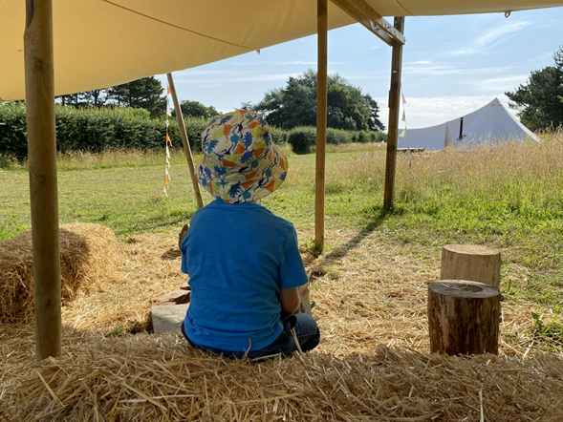
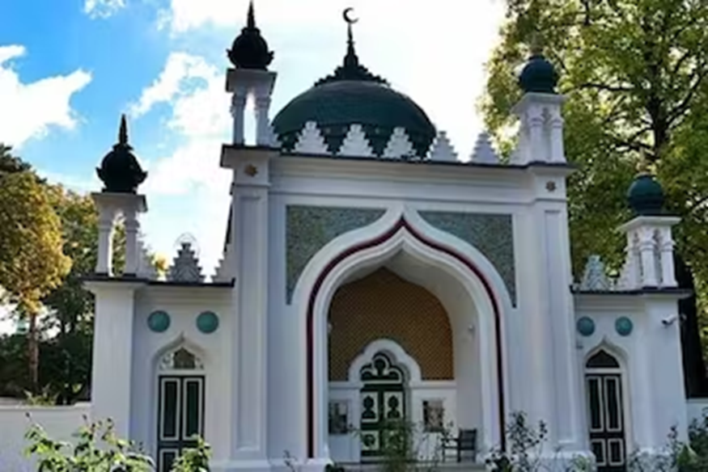
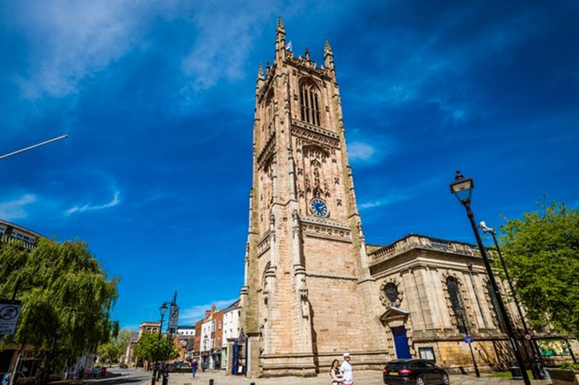
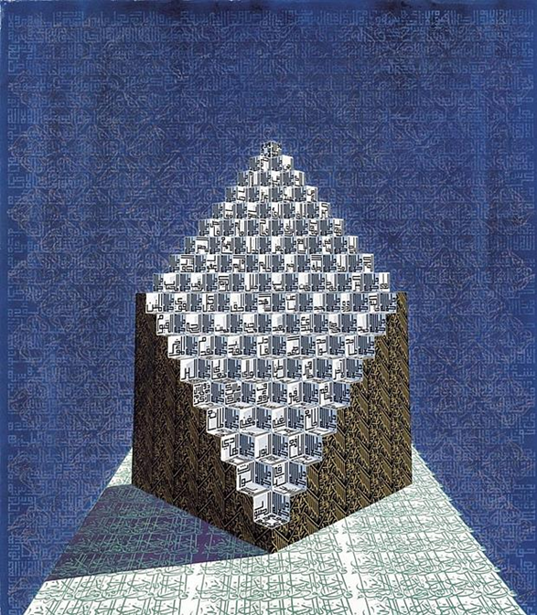
Lesson 1 –I can say what makes a place special or sacred.
special, sacred,
Lesson 2 –I can say why a mosque matters to the Muslim community.
sacred buildings, mosques,
Knowledge Organiser – KS2 Summer 2 2023
Lesson 4 –I can say how Christians use artwork to worship and remember Jesus.
religious art
Lesson 5 –I can say how Muslims try to change the world by being generous and charitable.
charities, generosity
Lesson 3 –I can explain why Christian cathedrals are of value to those who worship there. cathedrals, sacred buildings
Lesson 6 –I know Jesus’ ideas about helping people and generosity.
Generosity
Years 3 and 4 – Is it better to express your religion in art and architecture or in charity and generosity?

Slide 2
Lesson 1 –I can notice differences and similarities between religious buildings and say why they were built.
special, sacred,
Lesson 2 –I can present some ideas on the value of Muslim architecture to the class.
sacred buildings, mosques,
Knowledge Organiser – KS2 Summer 2 2023
Lesson 4 –I know some examples of Muslim artwork and can choose those which are most impressive.
religious art
Lesson 5 –I can investigate how Muslims believe that giving away money is important and can research an example of this.
charities, generosity
Lesson 3 –I can explain how cathedrals are built ‘to the glory of God’. I can compare Christian and Muslim religious architecture. cathedrals, sacred buildings
Lesson 6 –I know how charities such as Christian Aid are trying to change the world.
Generosity
Years 5 and 6 – Is it better to express your religion in art and architecture or in charity and generosity?

