Slide 1

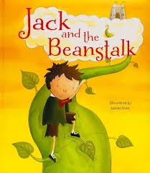


English
For the first half term, our focus text is ‘Jack and the Beanstalk’. Through this text we will be exploring what a ‘ conquering the monster tale is’ and looking at explanation text about how a creature changes caterpillar changes. For the second half term we will be looking at the Rags to Riches tale of ‘Pirate Tom’ and then creating a recount (diary) about a Pirate’s life.
Maths
In Year 1 Maths, we will be focusing on fractions, time and position and direction
In Year 2 Maths we will be fractions, multiplication and division. And money and time
Curriculum Leaflet
Garden Class
Year 1/2
Summer Term
2024
Physical Education
This half term we will be learning about running and jumping
Religious Education
In RE, we will focusing on ‘What is the good news Christians believe Jesus brings and What places are special and why
Computing
We will be making music and programming quizzes
Science
We will be learning about what plants need to grow and stay healthy and learning about living things and their habitats
Jesus said, "Let the little children come to me, and stop keeping them away, because the kingdom from heaven belongs to people like these” (Matthew 19:14)
PSHE: Rights and Responsibilities –looking after our friends, family and our environment.
In the second half of the summer term we will be looking at the unit ‘Being our Best’ – having a growth mind set, looking after our bodies and minds, knowing about a healthy lifestyles, looking after our teeth and understanding the importance of praise and support.
British Values: Democracy, Rule of law, Individual liberty, Tolerance, Mutual Respect
Art
We will be looking at sculpture and ‘Making Birds’’
History
We will be looking at the seaside in the past
Music – Your Imagination
The children will be listening to and performing songs about using your imagination.
Geography
We will be looking at the features of China

