Slide 1
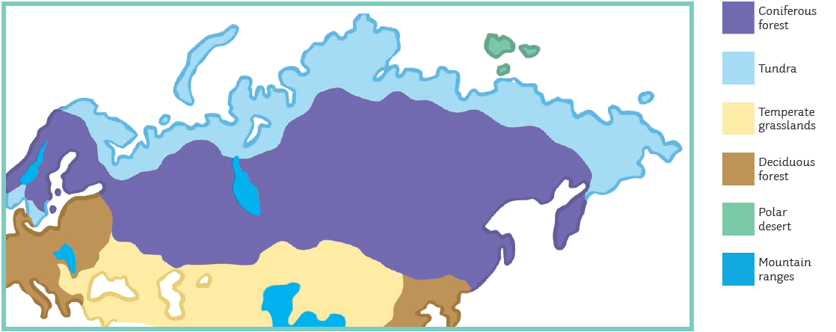
Russia Knowledge Organiser LKS2
Key Vocabulary: -
Atlas
Longitude and latitude - Latitudes are horizontal lines that measure distance north or south of the equator. Longitudes are vertical lines that measure east or west of the meridian in Greenwich, England.
Northern and Southern Hemisphere
Biomes - areas of the planet with a similar climate and landscape, where similar animals and plants live.
Seasonal Changes
Temperature
Population
Settlements and Land use

Slide 2
Russia Knowledge Organiser UKS2
Key Vocabulary: -
Atlas
Longitude and latitude - Latitudes are horizontal lines that measure distance north or south of the equator. Longitudes are vertical lines that measure east or west of the meridian in Greenwich, England.
Tropic of Cancer and Tropic of Capricorn - The Tropic of Cancer is an imaginary latitude line above the equator that runs across the globe at about 23 degrees north, while the Tropic of Capricorn is an imaginary latitude line below the equator whose latitude line circles the globe at about 23 degrees south.
Biomes - areas of the planet with a similar climate and landscape, where similar animals and plants live.
Seasonal Changes
Temperature
Population
Natural Resources

