Slide 1

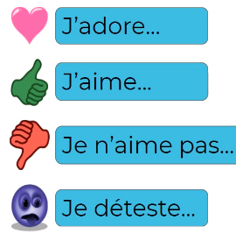
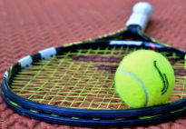
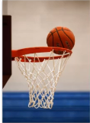
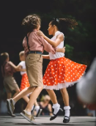
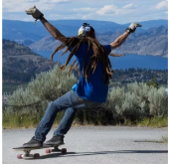
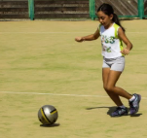
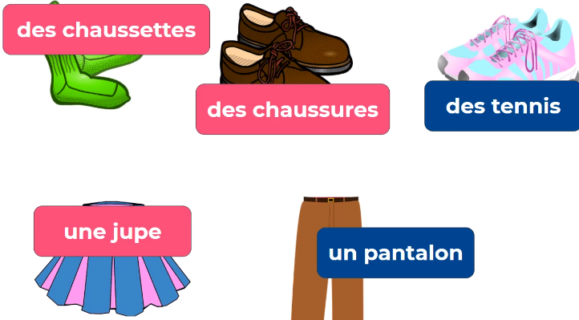






Je fais du sport- Spring 1
New Knowledge
I know names of different sports in French.
I know how to say what sports I do and don’t play using je joue and je ne joue pas
I know how to give my opinion on sports usinf j’adore a and he dêteste
I know how to say what sports can be played in the hot, cold and wind
I know some sports clothing in French.
Sticky learning
I know hot and cold in French.
Year 6
I know how to give my opinion

Slide 2
Je fais du sport- Spring 1
Weather
Il y a du vent | It’s windy
Chaud | Hot
Froid | Cold
Numbers
un | 1
deux | 2
trois | 3
quatre | 4
cinq | 5
six | 6
sept | 7
huit | 8
neuf | 9
dix | 10
onze | 11
douze | 12
Sports
Le tennis | Tennis
Le basket | Basketball
La danse | Dance
Le skate | Skateboarding
Le foot | Soccer / Football
Le vélo | Cycling
La natation | Swimming
La pétanque | Pétanque (French bowls)
Expressions
je joue | I play
je ne joue pas | I don’t play
je fais | I do
je ne fais pas de | I don’t do
J’aime | I like
Je n’aime pas | I don’t like
J’adore | I love
Je déteste | I hate
Clothing
Des chaussures de foot | Football shoes
Des chaussures de danse | Dance shoes
Un maillot de bain | Swimsuit
Un short | Shorts
Un tee-shirt | T-shirt

