Slide 1
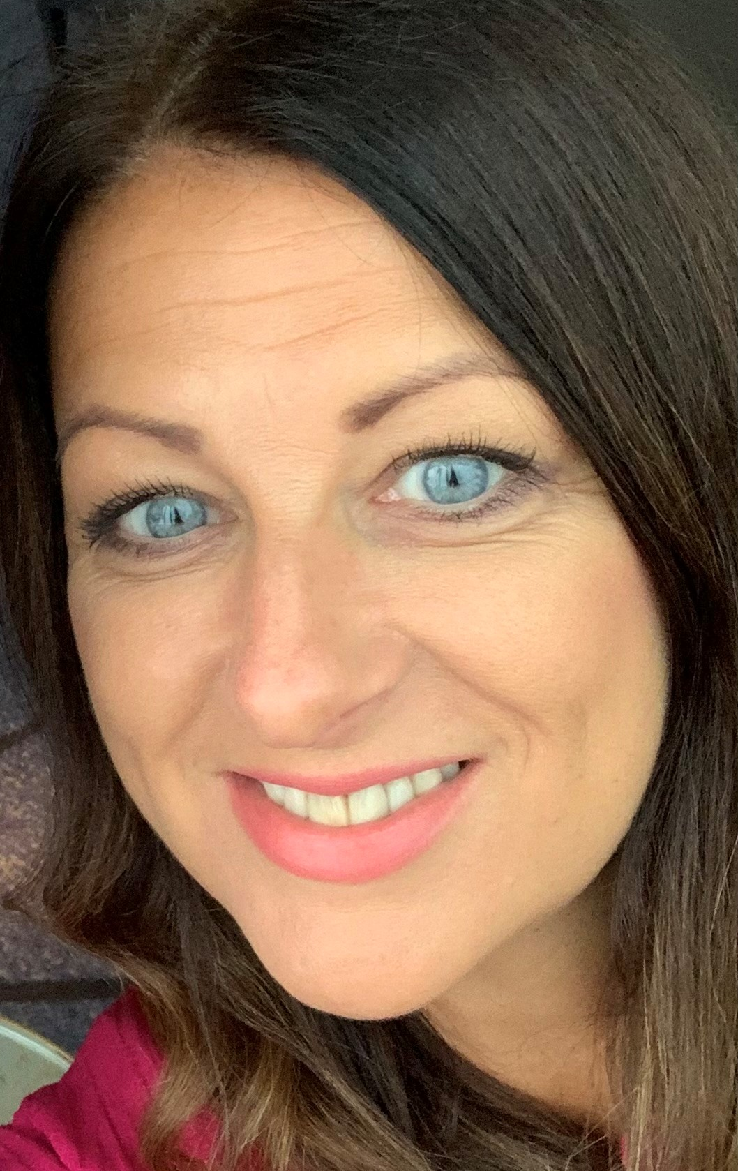
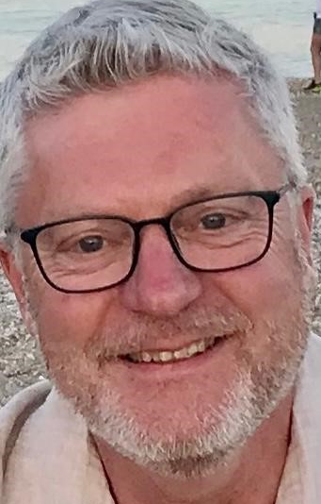
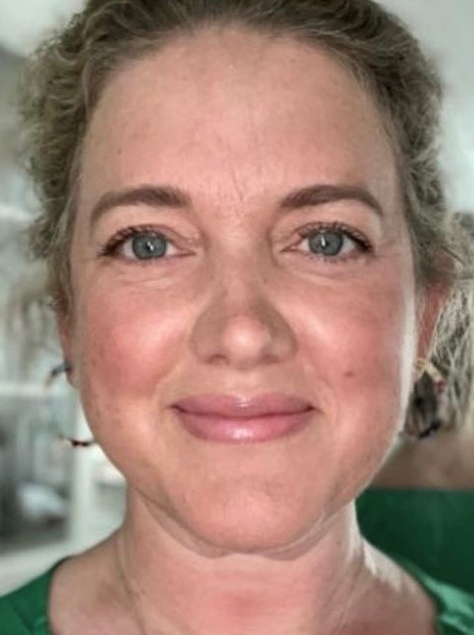
Acorn Federation Governing Board
We are always happy to chat if you have anything you wish to discuss!
Chair of Governors – ryemm@acornfed.derbyshire.sch.uk
Clerk to Governors - acornfederationclerk@marstonmontgomery.derbyshire.sch.uk
Chair of Governors | Vice Chair | Staff Governor | Parent Governor (MM) | Parent Governor (LL) | Foundation Governor
Rachel Yemm | Simon Dowdy | Kirsty Murby | Amanda Haymes | Claire Shardlow | Helen Foley

