Slide 1



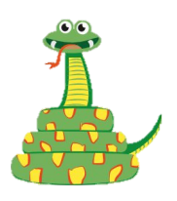
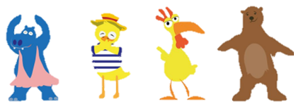
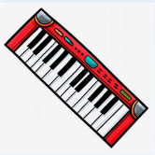

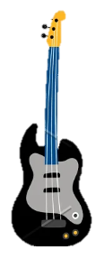


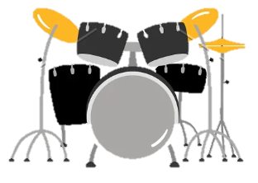
KS1
Vocabulary
Keyboard, drums, bass, electric guitar, friendship, pulse, rhythm, pitch, improvise, compose, perform, audience, melody, dynamics, tempo
Listening
Instruments/voices you can hear: Keyboard, drums, bass, a female singer, a glockenspiel
Musical Activities
Find the pulse!
Be an animal of your choice
Clapping
Rhythms
Perform & Share
Have a think…
What did you like doing best?
😃 😐 🙁 Singing?
😃 😐 🙁 Playing?
😃 😐 🙁 Dancing?

