Slide 1



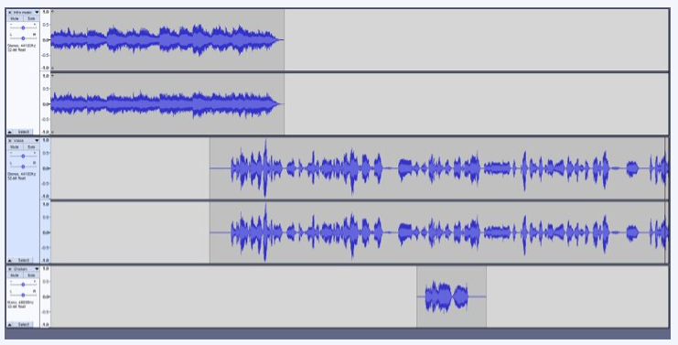



Lesson 1
Identify the input and output devices
Audio, microphone, speaker, headphones, input device, output device
Lesson 2
To explain that audio recordings can be edited​
Audio, sound, podcast,
edit, trim, align
Knowledge Organiser
Lesson 3 - Creating a podcast
Audio, sound, layer, import
Lesson 4
Apply audio editing skills
Audio, sound,
record, edit
playback,
selection
Lesson 5
Combining Audio
Audio, sound,
load, import,
save, export,
MP3
Lesson 6 – Evaluate editing choices made
Export, MP3, audio,
editing, evaluate, feedback
UKS2 Audio Production
Summer Term

