Slide 1
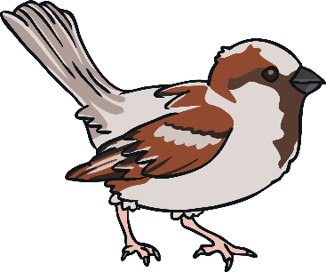
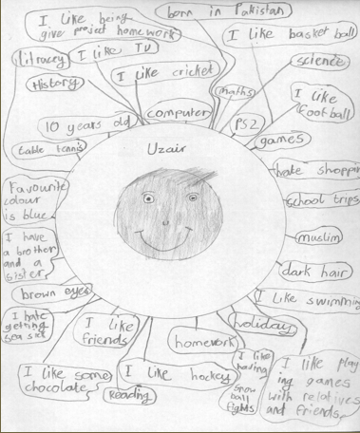
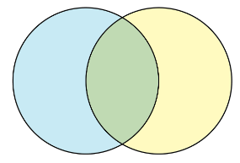
PHSE: Year 3/4 - Summer Term – Being Me: Knowledge Organiser
LKS2 Lesson 1 – I can create my identity circle
Key vocabulary - identity, likes, dislikes, hobbies, interests
LKS1 Lesson 2 – I understand what makes me unique
Key vocabulary - unique, different, individual
LKS2 Lesson 6 – I can create a personal shield
Key vocabulary – communities, unique
LKS2 Lesson 5 – I can identify the different communities I belong to
Key vocabulary - communities
LKS2 Lesson 3 - I can create a Venn Diagram of people’s differences
Key vocabulary - Venn, visible, invisible, respect
LKS2 Lesson 4 - I can identify key people in my school community
Key vocabulary - key people, responsibilities

Slide 2
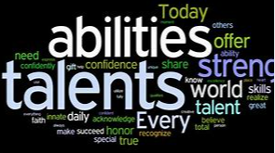
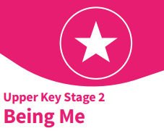
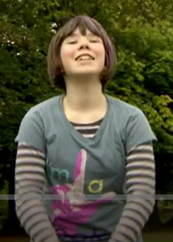
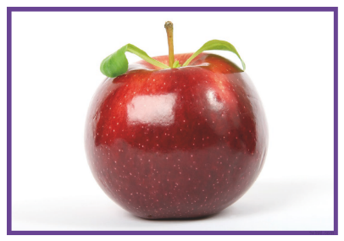
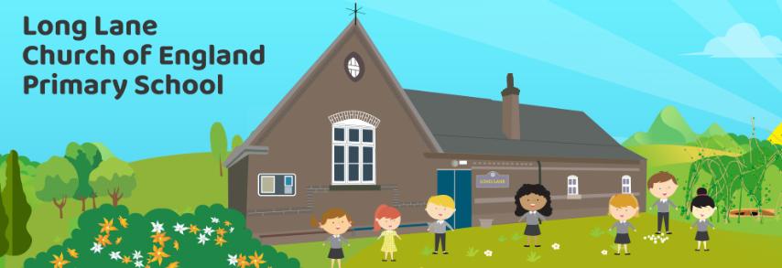
PHSE: Year 5/6 – Summer Term – Being Me: Knowledge Organiser
UKS2 Lesson 1 - I can identify my talents and set goals for the future
Key vocabulary - talents, similarities, differences, future goals
UKS2 Lesson 2 – I can identify differences that make people unique
Key vocabulary - differences, unique, strengths, qualities, discrimination
UKS2 Lesson 5 - I understand the benefits of living in a diverse community
Key vocabulary - community, respect, diversity
UKS2 Lesson 4 - I can explain how my school community is diverse
Key vocabulary - community, diversity
UKS2 Lesson 6 – I can explain what makes my school community stronger
Key vocabulary -ethos, community spirit, diversity
UKS2 Lesson 3 - I understand how discrimination and my own behaviours affects others
Key vocabulary - hate, discrimination

