Slide 1
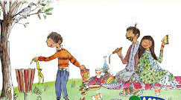
Lesson 1 – To understand what rules are and why different rules are needed for different situations
Rules, different, fair, unfair, consequence
Lesson 2 – To share opinions on things that matter to them
Decisions, fair, unfair, choice, rules
Knowledge Organiser – PSHE 2023
Lesson 3 –To recognise that people and other living things have different needs and understand the responsibilities of caring for them
Choice, responsibilities
Lesson 4 –To explain some things they can do to help look after their environment
Responsibilities, nurture, care, rubbish, consequences
Lesson 5 –To know/recognise that people and other living things have different needs and understand the responsibilities of caring for them
Responsibilities, needs
Lesson 6 –To explore the different roles and responsibilities people have
Responsibilities, reduce, recycle, reuse
Year 1/2 –
Being Responsible

