Slide 1

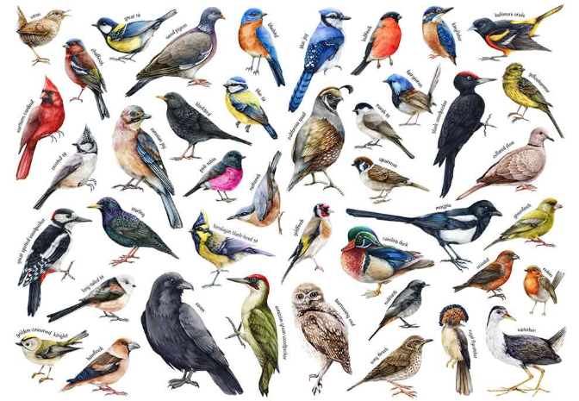

Knowledge Organiser – Birds (Lower Key Stage 2) –
Year B - Autumn
Sticky Knowledge - What I already know
Core Learning
I know how to use pencils to create lines of thickness in drawings.
I know how to choose and use three different grades of pencil when drawing.
I know how to use a viewfinder to focus on a specific part of an artefact before drawing it.
I know how to use charcoal, pencil and pastel to create art.
I know how to create a repeating pattern in print. To know how to create a printed piece of art by pressing, rolling, rubbing and stamping.
I know how to cut, roll and coil materials. To know how to make a nature sculpture. To know how to create sculptures with different materials.
I know how to respond positively to ideas and starting points.
I know how to explore ideas and collect information.
I know how to describe differences and similarities and make links to my own work.
I know how to try different materials and methods to improve.
To know how to draw details carefully
To know how to draw birds in pencils
To know how to ink print feathers
To know how to make a 3D model
To know how to finish and evaluate my artwork

Slide 2
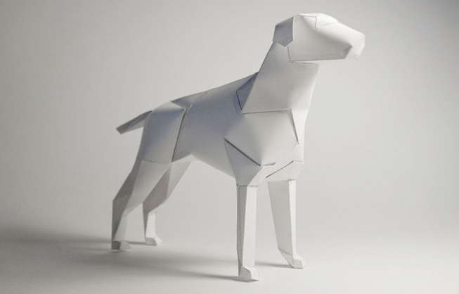
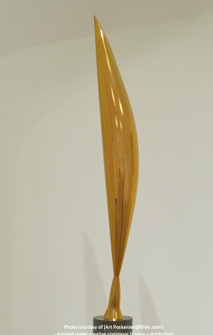
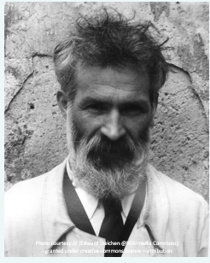


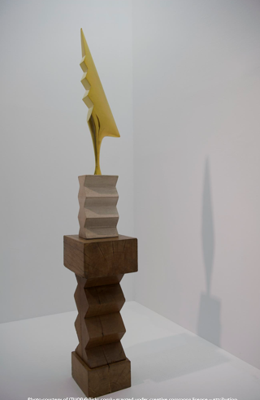
Artist Focus
Brancusi
Richard Sweeney

Slide 3
Key Vocabulary | Definition
texture | How something feels or looks like it would feel, such as rough, smooth, bumpy, or soft.
outline | The line around the outside edge of a shape or object.
block printing ink | A special thick ink used to print designs from a printing block onto paper or fabric.
form | The shape of an object that has height, width, and depth, making it look three-dimensional (3D).
evaluate | To think about what went well and what could be improved in your artwork.
polystyrene printing tiles | Soft foam sheets that artists press lines and patterns into to create printing blocks.
inking rollers | Tools used to spread ink evenly onto a printing block before printing. They are also called brayers.
layer | One part placed on top of another. Artists can add layers of colour, paint, ink, or materials to create effects.

