Slide 1
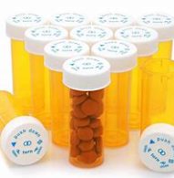
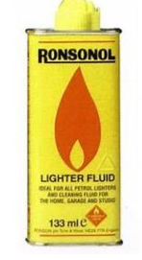
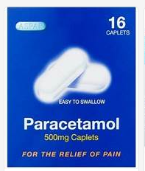
PHSE: Year 3/4 - Spring Term – Drug Education : Knowledge Organiser
LKS2 Lesson 1 –Explore characters that have particular conditions and discuss how these characters might feel
Key vocabulary - respect, support
LKS1 Lesson 2 - Explore everyday medicines and household product risks
Key vocabulary - medicine, household products, risk
LKS2 Lesson 6 – Identifying risks
Key vocabulary - risk
LKS2 Lesson 5 – I understand the positive and negative consequences of drugs.
Key vocabulary - lighter fluid, second-hand smoke
LKS2 Lesson 3 - Explore everyday medicines and household product risks
Key vocabulary - harmful
LKS2 Lesson 4 - I understand the risks and dangers of medicines.
Key vocabulary - medicine, risk, danger

Slide 2
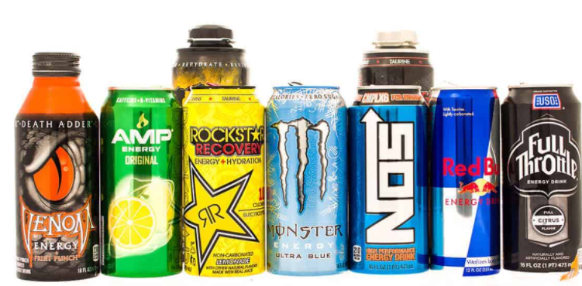
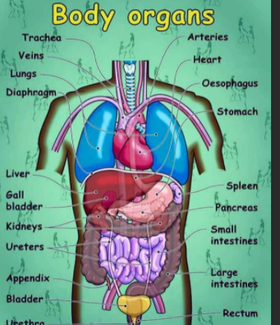
PHSE: Year 5/6 – Spring Term – Drug Education : Knowledge Organiser
UKS2 Lesson 1 - identify a range of drugs found in common drinks
Key vocabulary - soft drinks, energy drinks, alcoholic drinks, caffeine, obesity
UKS2 Lesson 2 - To identify a range of drugs and assess risks and effects
Key vocabulary - slogan, health risks
UKS2 Lesson 5 - I understand the harmful effects of cigarettes (continued)
UKS2 Lesson 4 - I understand the harmful effects of cigarettes
Key vocabulary - Tobacco, chemicals, addiction, nicotine, cigarettes, e-cigarettes
UKS2 Lesson 6 - The history of cigarettes
Key vocabulary - ration packs, addiction, habit, informed choice
UKS2 Lesson 3 - To understand the harmful effects of alcohol
Key vocabulary - organs

