Slide 1


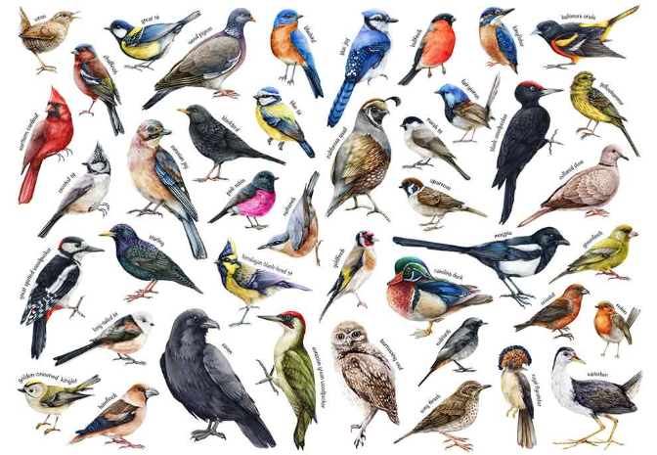
Knowledge Organiser – Birds (Upper Key Stage 2) –
Year B - Autumn
Sticky Knowledge - What I already know
Core Learning
I know how to use sketches to produce a final piece of art.
I know how to use different grades of pencil to shade and to show different tones and textures.
I know how to use marks and lines to show texture in my art.
I know how to use line, tone, shape and colour to represent figures and forms I movement.
I know how to show facial expressions and body language in sketches and paintings.
I know how to use more than one colour to layer in a print.
I know how to replicate patterns from observations.
I know how to print onto different materials using at least four colours.
I know how to cut, make and combine shapes to create recognisable forms.
I know how to add materials to the sculpture to create detail.
I know how to sculpt clay and other mouldable materials.
I know how to use my sketchbook to record ideas.
I know how to explore ideas from first-hand observations.
I know how to question and make observations about starting points, and respond positively to suggestions.
I know how to adapt and refine ideas.
I know how to use key vocabulary to demonstrate knowledge and understanding in this strand: line, pattern, texture, form, record, detail, question, observe, refine.
To know how to draw details carefully
To know how to draw birds in pencils
To know how to ink print feathers
To know how to make a 3D model
To know how to finish and evaluate my artwork

Slide 2
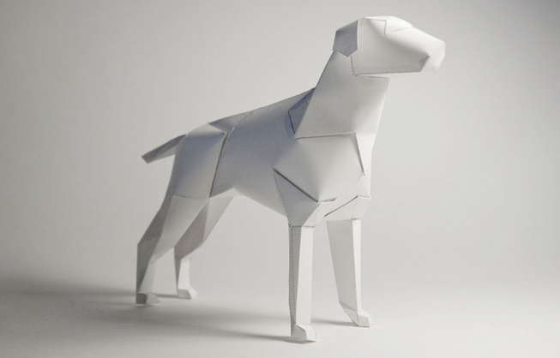
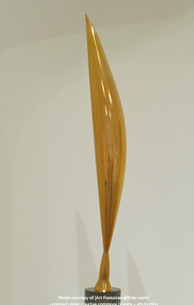
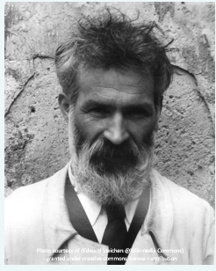
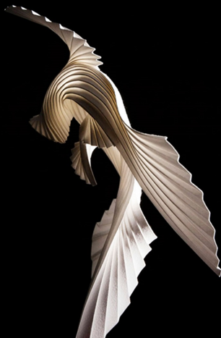
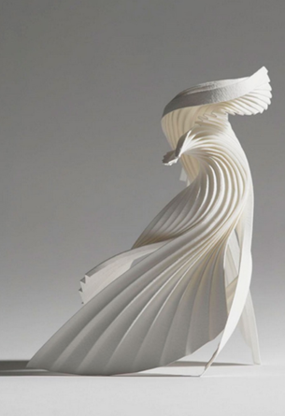
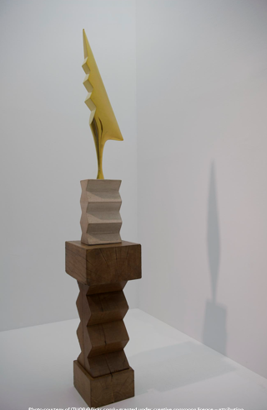
Artist Focus
Brancusi
Richard Sweeney

Slide 3
Key Vocabulary | Definition
hard | Make light, neat lines that are good for details.
soft | Make dark lines that are good for shading and adding tone.
tiles | Flat pieces of material, often ceramic, clay, or stone, that can be decorated and arranged to create patterns, pictures, or mosaics.
wire | A thin, flexible metal material that can be bent, twisted, and shaped to create structures, sculptures, and forms.
technical vocabulary | Special words used in art to describe techniques, materials, processes, and equipment accurately.
arrange | To organise, position, or place objects carefully to create a planned design or composition.

