Slide 1
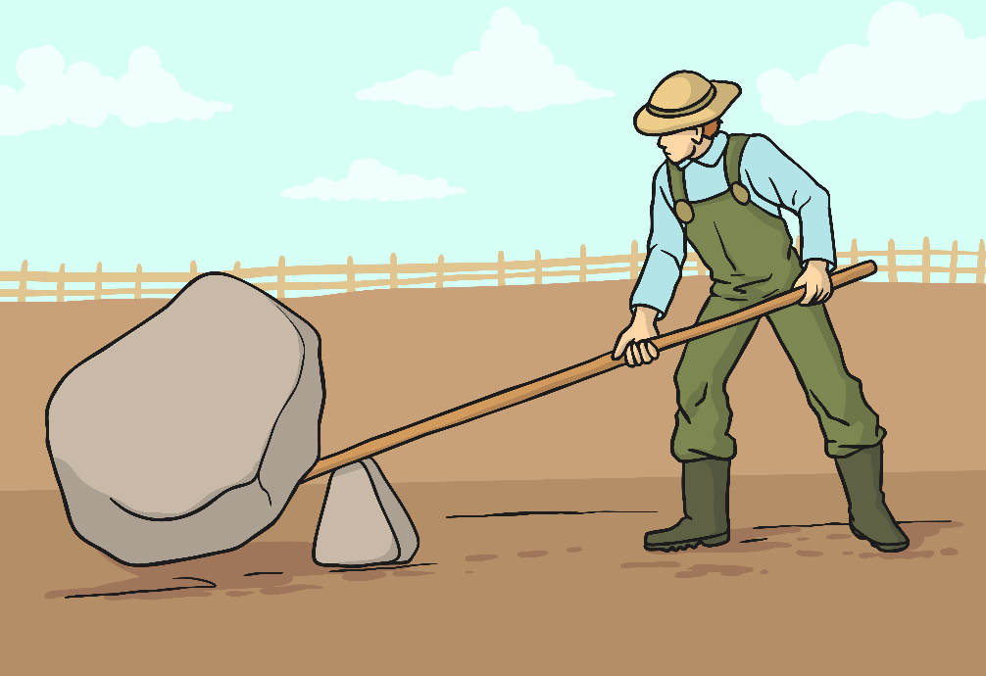
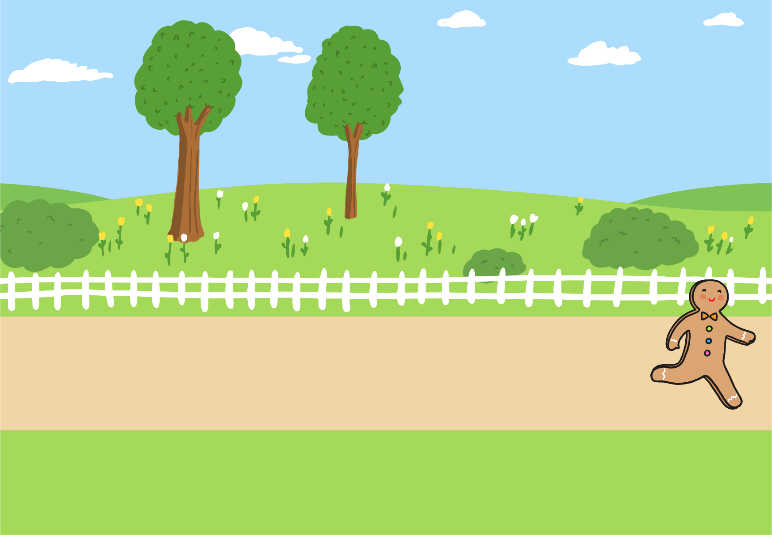
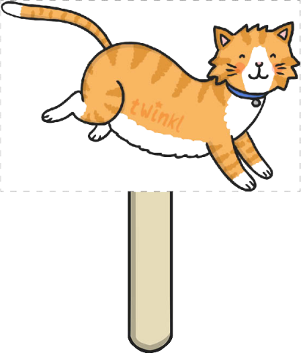
Design and Technology: Year 1 – Spring Term – Mechanisms – Sliders and Levers: Knowledge Organiser
De
Lever - a bar which turns around a point/pivot.
Pivot – appoint about which a lever turns
Key Vocabulary
Lesson 1 – Investigate books with moving parts
Lesson 3 – Levers
Lesson 2 – Sliders
Lesson 4, 5 & 6 – Design, make and evaluate
Process: investigate,
design, planning,
evaluate

Slide 2
Design and Technology: Year 2 – Spring Term – Mechanisms – Sliders and Levers: Knowledge Organiser
De
Lever - a bar which turns around a point/pivot.
Pivot – appoint about which a lever turns
Key Vocabulary
Lesson 1 – Investigate books with moving parts
Lesson 3 – Levers
Lesson 4, 5 & 6 – Design, make and evaluate
Lesson 2 – Sliders
Process: investigate,
design, planning,
evaluate, design criteria

