Slide 1
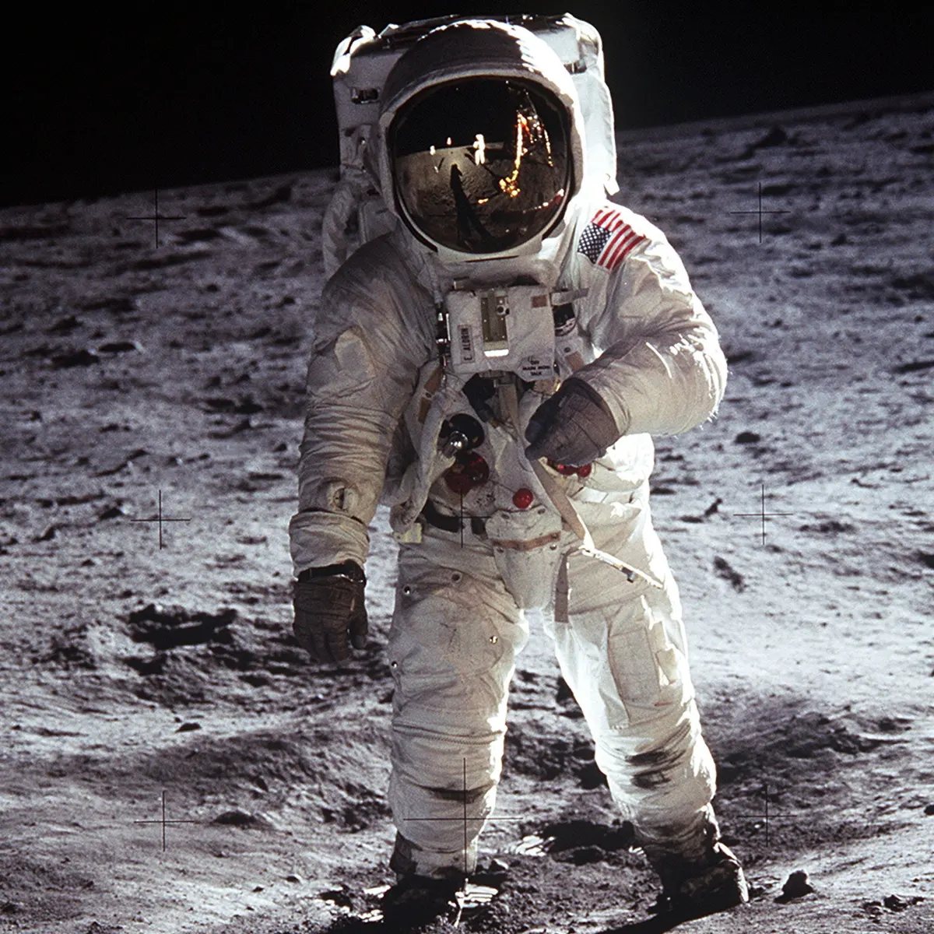
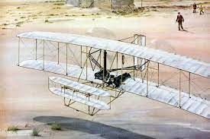
Lesson 1 –I know why the Wright Brothers were famous.
first flight, aeroplane, Wright Brothers
Lesson 2 –I can share the story of how the Wright Brothers became famous with a group
Flight, aero-plane, Wright Brothers
Knowledge Organiser – KS1 History Sum 1 2023
Lesson 3 –I know that we use different sources to tell us about life in the past.
source, evidence
Lesson 4 I can say some changes in flight since the Wright Brothers flight.
powered flight, chronology, changes
–
Lesson 5: I can say facts about the Moon landing.
moon landing, astronauts, Neil Armstrong.
Year 1 – The Wright Brothers to the Moon Landings
Lesson 6 –I can say why people would want or not want to go to the Moon. reasons, debate.

Slide 2
Lesson 1 –I know the impact that the Wright Brothers invention had on flight. first flight, aeroplane, Wright Brothers, inventor, impact
Lesson 2 –I can sequence the story of how the Wright Brothers became famous and know the important turning points.
Flight, aero-plane, Wright Brothers, chronological
Knowledge Organiser – KS1 History Sum 1 2023
Lesson 3 –I can say how different sources of evidence tell us about the past.
source, evidence, newspaper report, diary
Lesson 4 I can suggest which changes were most significant..
powered flight, chronology, changes, significant
Lesson 5- I can suggest why an astronaut might have wanted to go to the Moon.
moon landing, astronauts, Neil Armstrong, mission, motivation.
Year 2 – The Wright Brothers to the Moon Landings
Lesson 6 – I can give arguments for and against space travel. reasons, debate, space exploration.

