Slide 1

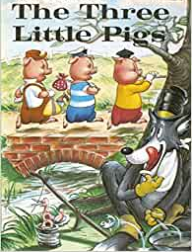
English
This term, our focus text this term is ‘ The 3 little pigs and we will be looking at ‘ defeating the monster’ stories and creating wanted posters
Forest School
This half term we will be getting outside to further develop our forest school skills
Maths
In Maths, we will be focusing on time and fractions.
Curriculum Leaflet
Garden Class
Year 1/2
Spring Term 2
2023
History
In history we will be learning about Grace Darling
Computing
We will be learning about simple programming and learning how to move a robot
Physical Education
This half term we will be learning to play tag rugby
Jesus said,”Let the little children come to me, and stop keeping them away, because the kingdom from heaven belongs to people like these” (Matthew 19:14)
Science
As scientists, we will be learning about everyday materials and their uses
Design and Technology
We will looking at mechanisms including sliders and levers and creating moving pictures .
Music
Our unit is called Zootime and we will be exploring reggae music
Religious Education
In RE, we will be exploring how Christians celebrate Easter
Collective Worship – Lent, World Book Day, Mothering Sunday, Glabal neighbours, Easter
PSHE: Difference and diversity
British Values: Democracy, Rule of law, Individual liberty, Tolerance, Mutual Respect

