Slide 1

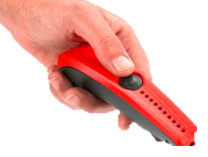

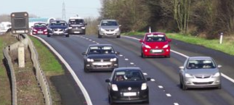




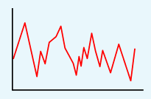

Lesson 1
Answering questions about the data collected.
Data, table, layout
Lesson 2
Collecting data
Using recording
Devices.
Input device, sensor, data logger
Knowledge Organiser
Lesson 3 - Logging
Recording the data using Excel.
Data logger, logging, data point, interval
Lesson 4
Analysing the Data.
Data logger,
logging,
data point,
interval
Lesson 5
What does the data show you?
Data, data logger, logged, collection
Lesson 6 – Answering my Question
After data has been collected, it needs
to be analysed.
Analyse, review, conclusion
LKS2 Data Logging
Spring Term

