Slide 1
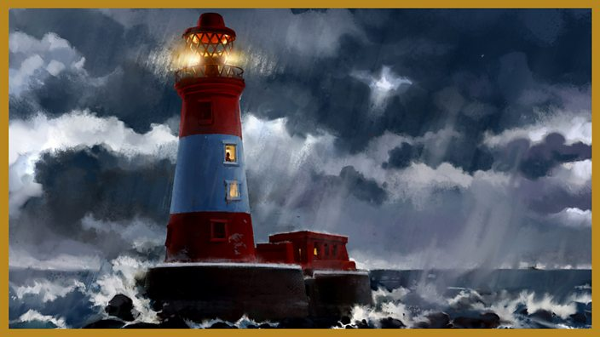
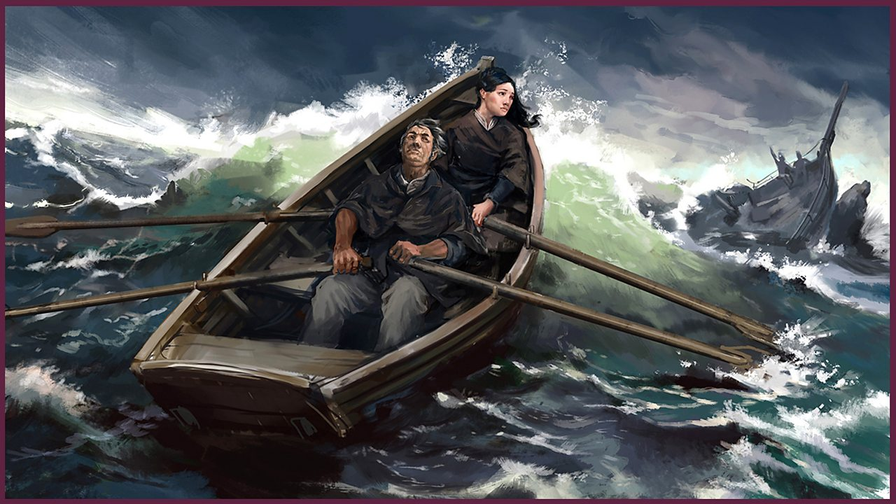
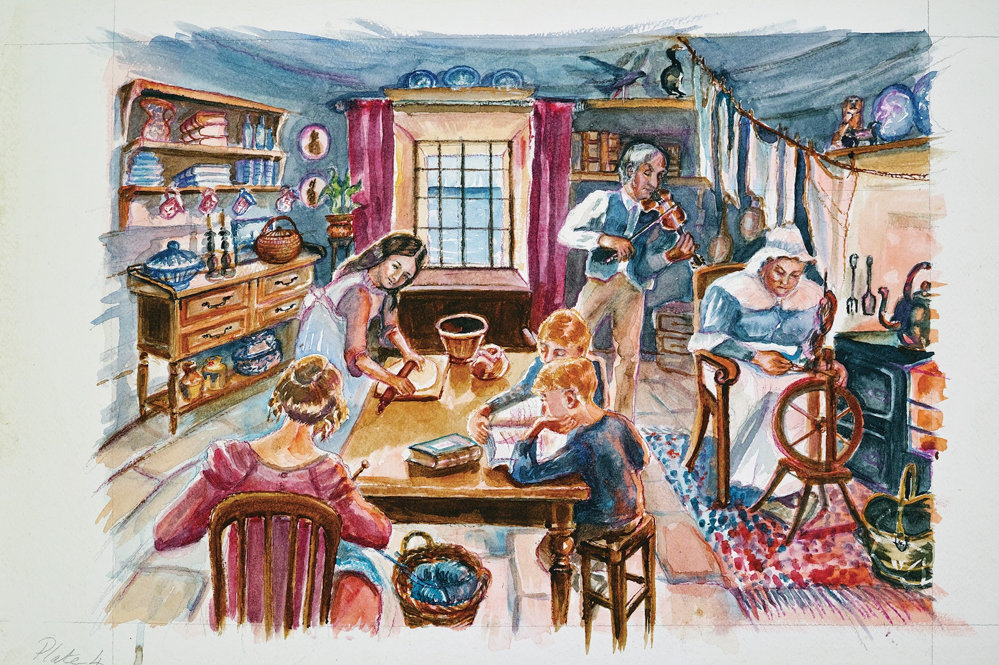
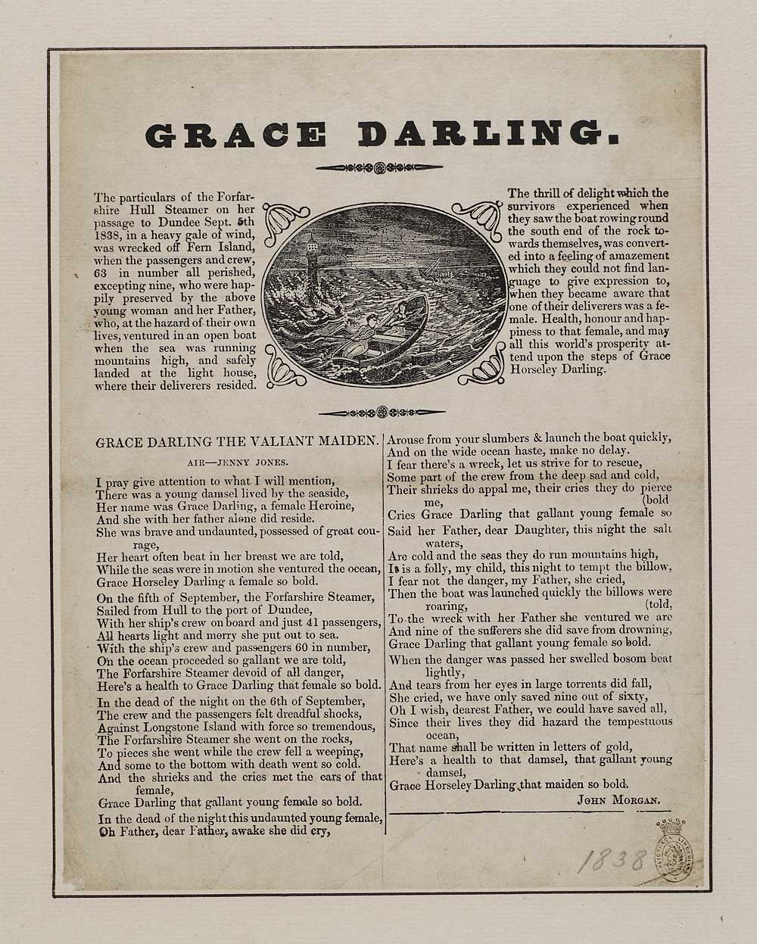
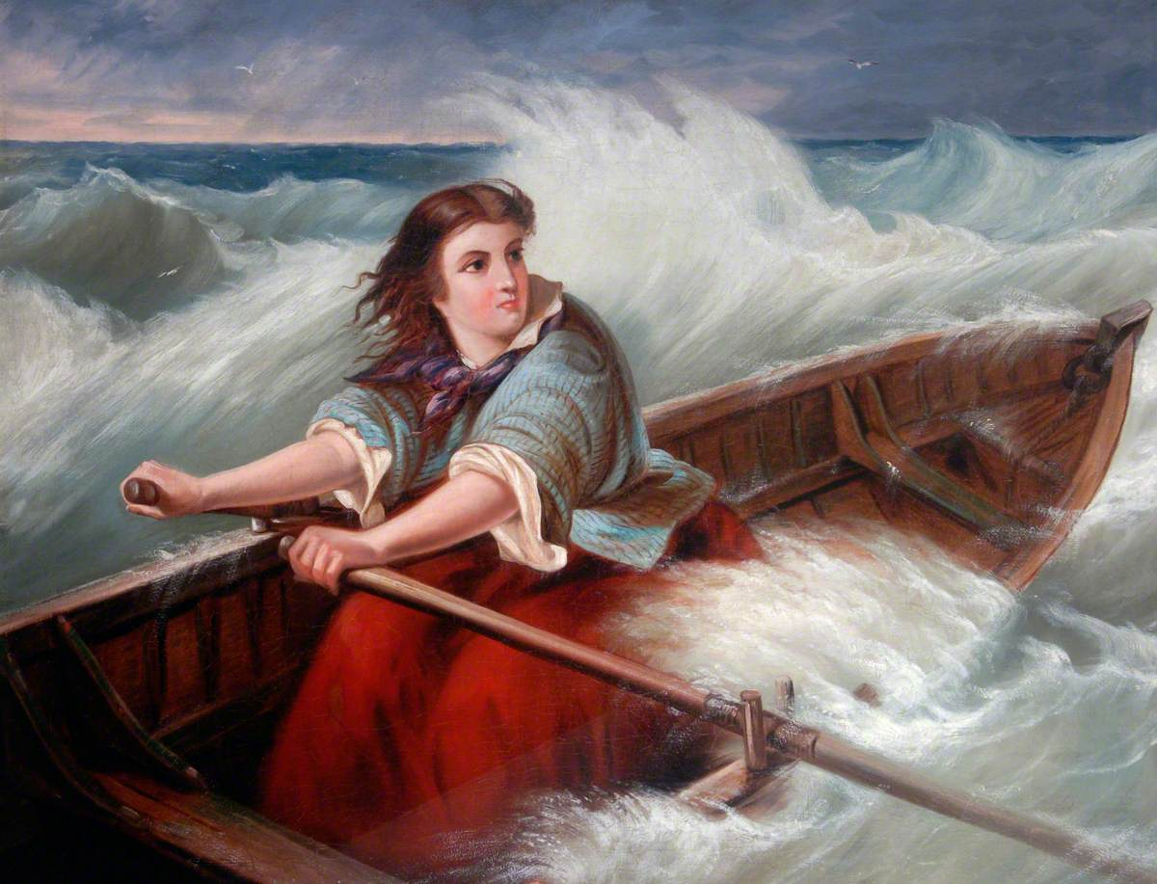
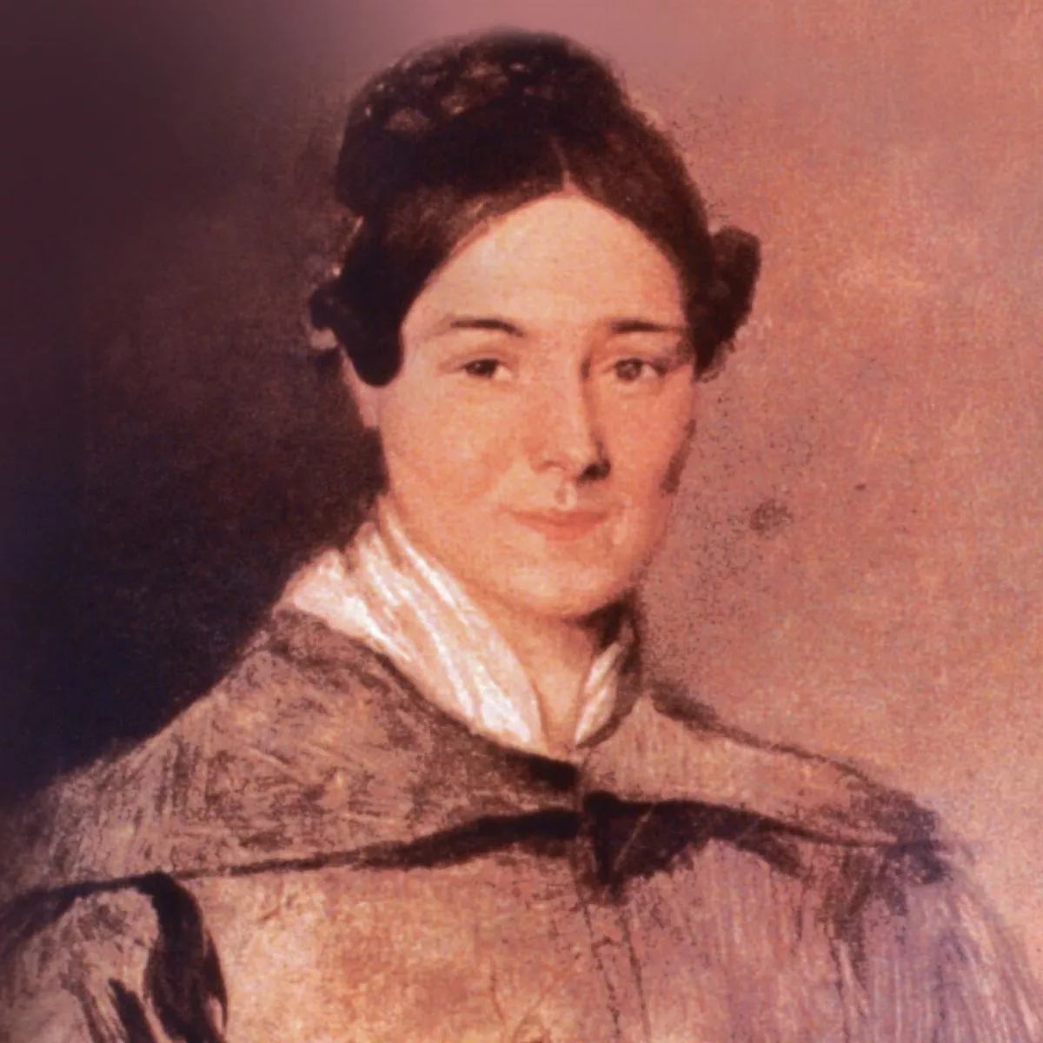
Lesson 1 – Use clues in a picture to make predictions.
Say why Grace Darling was famous.
famous, Victorian, rescue, lighthouse
Lesson 2 –Suggest why Grace carried out the rescue.
Write what Grace might have said about the rescue.
Heroic, fearless, courageous
Knowledge Organiser – History 2023
Lesson 3 –Use drama to show Grace’s daily life accurately.
Draw a picture and write a sentence about Grace’s daily life.
Victorian, clues, everyday life
Lesson 4 –Describe differences in pictures of an event.
Choose a picture and say why it was chosen.
Differences, views
Lesson 5 –Give an example of a source.
With support, find at least one source of evidence for a statement.
Sources, newspapers, true.
Year 1 – Grace Darling
Lesson 6 –Choose a way to remember Grace Darling.
Draw item with some detail of Grace’s story.
Remember, item, special

Slide 2
Lesson 1 –Use clues in a picture to make predictions. Sequence the story of Grace accurately.
Say why Grace Darling is remembered today.
famous, Victorian, rescue, lighthouse, remembered, shipwreck
Lesson 2 –Put into order of importance reasons why Grace might have carried out the rescue.
Give reasons why Grace’s actions were seen as special.
Heroic, fearless, courageous, motivation
Knowledge Organiser – History 2023
Lesson 3 – Discuss how Grace’s life was different from their own.
Include in a letter details of daily life in Grace’s family.
Victorian, clues, everyday life, household
Lesson 4 – Explain why pictures of Grace’s rescue might be different.
Give reasons why a picture might be accurate.
Differences, views, reasons
Lesson 5 –Name at least three sources of historical evidence.
With a partner, match at least four statements with an appropriate source.
Sources, newspaper reports, true.
Year 2 – Grace Darling
Lesson 6 –List three ways in which people can be remembered.
Choose one way and explain your choice.
Commemorate, item, significant individual

