Slide 1
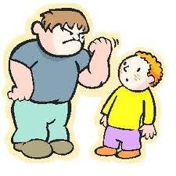
Lesson 1 – To explore what bullying is
Bullying, kind, unkind, bully, victim
Knowledge Organiser – PSHE 2023
Lesson 2 – To recognise kind and unkind behaviour in themselves and others
Kind, unkind
Lesson 3 –To identify that bodies and feelings can be hurt by words and actions and know hurtful behaviour is not acceptable
Bullying, included, excluded, kind, unkind, bully, victim, accident, purpose
Lesson 4 –To explore simple strategies to resolve arguments between friends
Different, similar, opposites, included, excluded, kind, unkind
Lesson 5 –To understand how to report bullying and who they can talk to.
Bullying, kind,unkind, bully, victim
Year 1/2 –
Bullying matters

