Slide 1
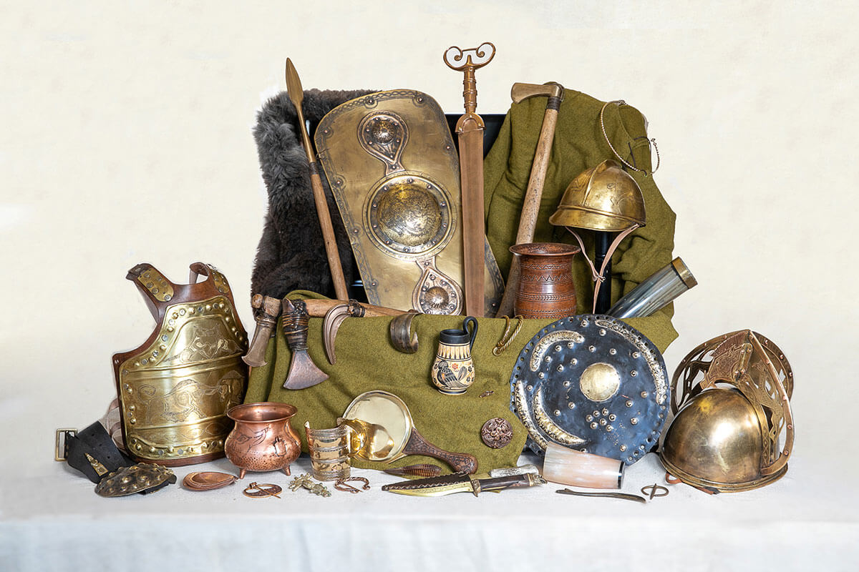
Lesson 1 –I can name important events during the Bronze Age. timeline, BC, metals, settlement, tools, Beaker culture
Lesson 2 – I can explain why Bronze Age burial sites were so important.
Amesbury Archer, round-barrows, artefacts, significance
Knowledge Organiser – KS2 Summer 2023
Lesson 3 – I can give facts about Stonehenge. Stonehenge, monument, standing stones, spiritual
Lesson 4 – I can describe an Iron Age house.
Roundhouse, one room, wattle and daub,
Lesson 5 - I know what Hill Forts were and why they were built.
Hill fort, ditch, bank, defence, tribes.
Years 3 and 4 – How Britain Changed from the Bronze Age to the Iron Age
Lesson 6 – I know about the life of an Iron Age Celtic Warrior.
Tribes, torcs, woad, intimidating

Slide 2
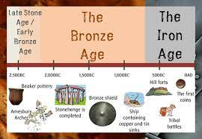
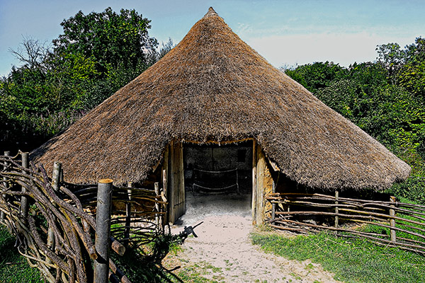
Lesson 1 –I can explain the significance of key dates and events during the Bronze Age. timeline, BC, metals, settlement, tools, Beaker culture, Stonehenge, tribal
Lesson 2 – I can explain using examples, how Round Barrows are an important source of information about the Bronze Age.
Amesbury Archer, round-barrows, artefacts, significance, grave goods, interpretation, Flag Fen
Knowledge Organiser – KS2 Summer 2023
Lesson 3 – I can use sources of evidence to learn about Stonehenge and its importance in the Bronze Age.
Stonehenge, monument, standing stones, spiritual, sources of research
Lesson 4 – I know from evidence how Iron Age people lived, including their houses and jobs.
Roundhouse, one room, wattle and daub, smelt, iron ore
Lesson 5 - I know examples of Hill Forts and how they tell us about life in Iron Age Britain.
Hill fort, ditch, bank, defence, tribes, Celtic, hillfort names.
Years 5 and 6 – How Britain Changed from the Bronze Age to the Iron Age
Lesson 6 – I know where the Celts came from and how they were important to Britain.
Tribes, torcs, woad, intimidating, Boudicca, Caractacus

