Slide 1
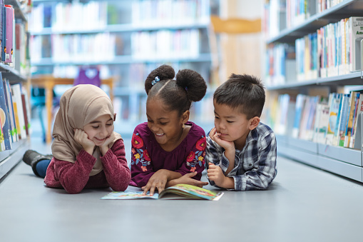
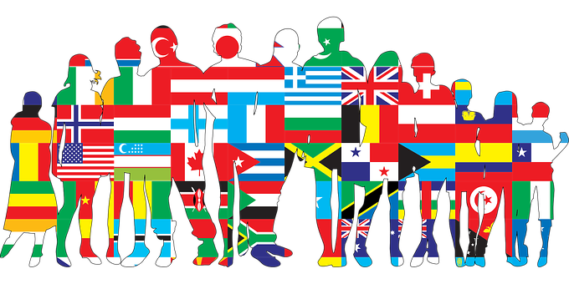
Lesson 1 – To know we are all unique and special
Similar, different, same, equal, special unique
Lesson 2 – To recognise that there are different types of families
Family, same, different
Knowledge Organiser – PSHE 2023
Lesson 3 –To identify common features of family life, recognising some families will be the same and some will be different
Same, different, family, unique
Lesson 4 –To recognise the ways in which people are the same as or different to each other.
Same, different, country, lives, relationships
Lesson 5 –To know how different individuals strengths and interests will enable them to do different jobs
interests, strengths, male, female, qualities, skills, gender, age
Year 1/2 – Difference and Diversity

