Slide 1


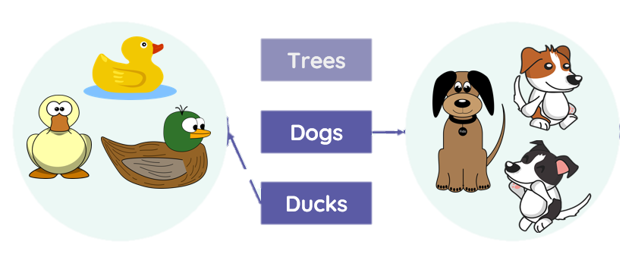
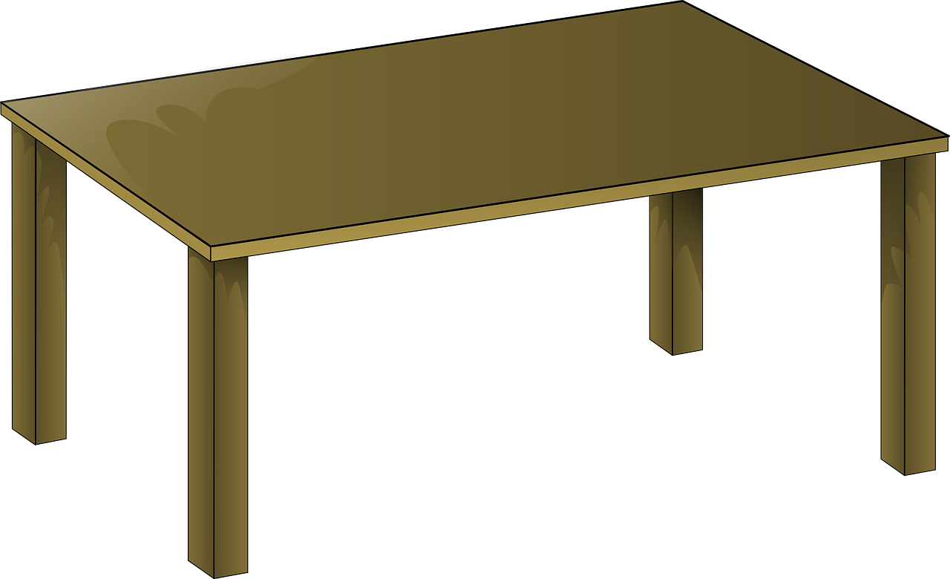
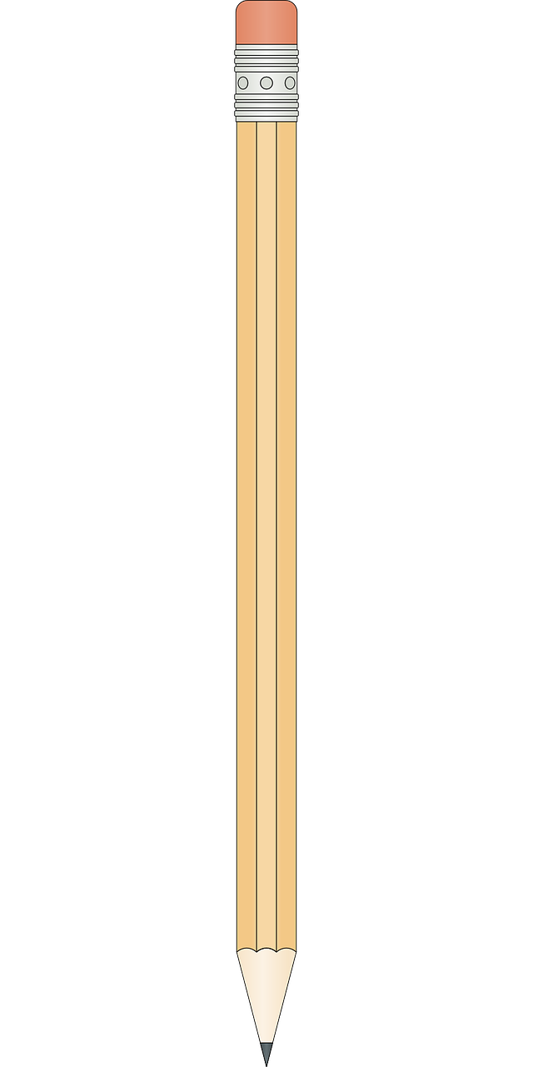

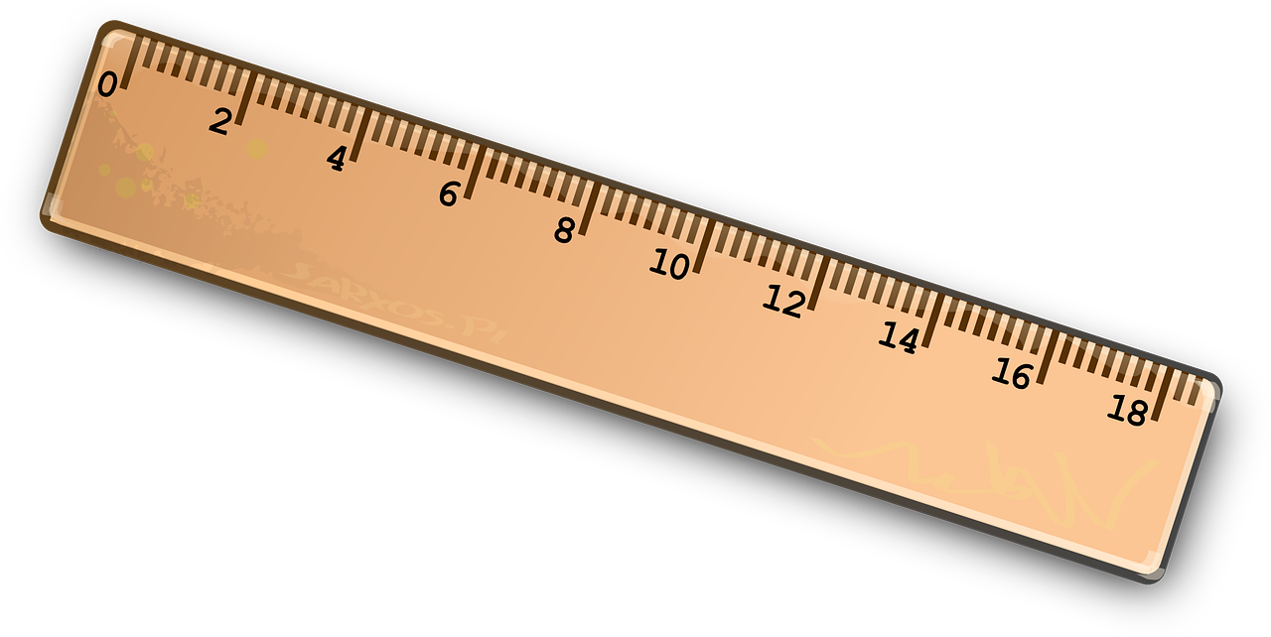
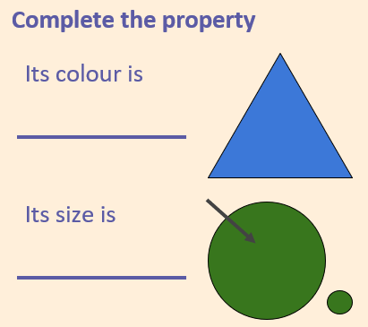


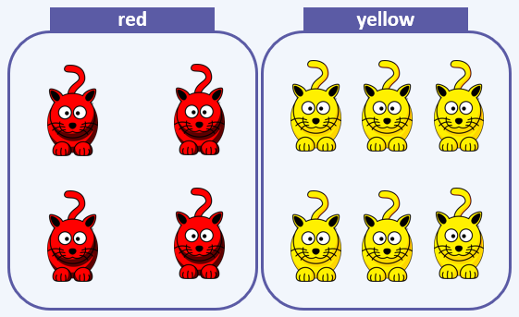


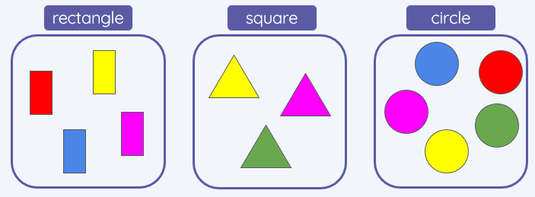
Lesson 1 – Label and Match
Object, label, group, search, image
Lesson 2 – Group and Count
Group, object,
label, image
Knowledge Organiser
Lesson 3 – Describe an Object
Group, object,
property, label,
colour, size, shape
Lesson 4 – Making Different Groups
Group, object,
property, value, label, colour, data set
Lesson 5 – Comparing Groups
object, value,
label, colour,
size, shape,
more, less, most, fewest
Lesson 6 –
Answering Questions
Group, object, property, value, label, colour, data set, more, less, most, least, fewest, the same
KS1 Data and Information
Grouping Data - Summer Term

