Slide 1
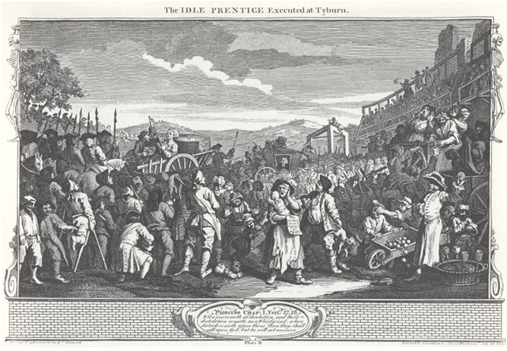
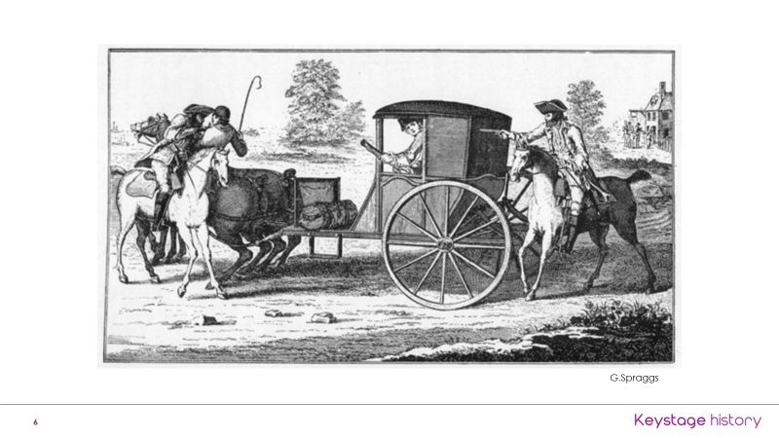
Lesson 1 – Crime in medieval times, community justice, story of the Fox and Goose, fairness of punishments.
crime, punishment, medieval, community
Lesson 2 – story of Robin Hood, outlaws and sheriffs, rich and poor divide
legend, outlaw, justice, unfair
Knowledge Organiser – KS2 Summer 1 2023
Lesson 3 – change and continuity between 1500 and 1750. New crimes such as vagrancy and highway robbery
whipping, vagrancy/begging, highwayman, smuggling, poaching, witchcraft, deter/deterrent.
Lesson 4 – The Bloody Code, the Idle Prentice by Hogarth and what it meant.
Bloody Code, deter/deterrent, capital punishment, humiliation
Lesson 5 – 19th Century, prisons, transportation, Police Force, debate on prisons. Mostly minor crime
prisons, transportation, crime rates, Police Force
Lesson 6 – changes in types of crimes from 20th to 21st Century. Prison population, optimism and pessimism about the future
optimistic, pessimistic, cybercrime, drug crime
Years 3 and 4 – Crime and Punishment

Slide 2
Lesson 1 – Crime in medieval times, community justice, story of the Fox and Goose. Why so many crimes and so few found guilty?
crime, punishment, medieval, community, justice, petty crime
Lesson 2 – story of Robin Hood, outlaws and sheriffs, rich and poor divide, differences in courtrooms
legend, outlaw, justice, unfair, features, courttroom
Knowledge Organiser – KS2 Summer 1 2023
Lesson 3 – change and continuity between 1500 and 1750. New crimes such as vagrancy and highway robbery
whipping, vagrancy & begging, highwayman, smuggling, poaching, witchcraft, deter/deterrent, change and continuity
Lesson 4 – The Bloody Code, the Idle Prentice by Hogarth and how to interpret it.
Bloody Code, deter/deterrent, capital punishment, humiliation, reasoning
Lesson 5 – 19th Century, prisons, transportation, Police Force, debate on prisons. Mostly minor crime, harshness of punishments
prisons, transportation, crime rates, Police Force, harsh, lenient
Lesson 6 – changes in types of crimes from 20th to 21st Century. Prison population, optimism and pessimism about the future
optimistic, pessimistic, cybercrime, drug crime, current/future
Years 5 and 6 – Crime and Punishment

