Slide 1
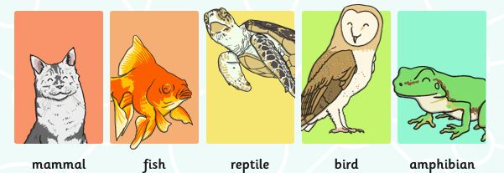
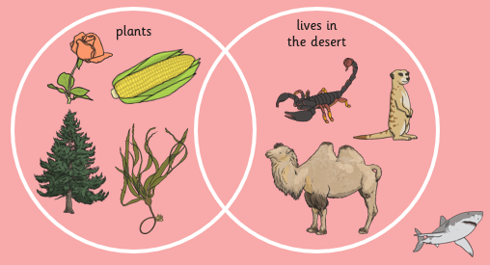
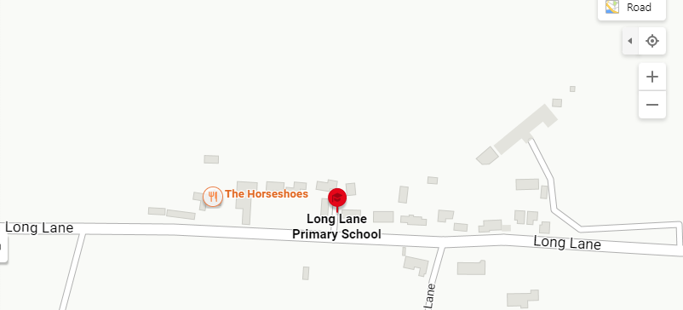
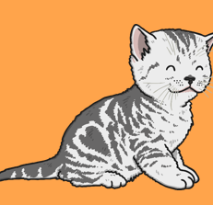
PHSE: Year 3/4 – Summer term – Science : Knowledge Organiser
LKS2 Lesson 1 – grouping living things
Key vocabulary - organism, sort, group, criteria, Venn diagram, Carroll diagram
LKS1 Lesson 2 - identify vertebrates by observing their similarities and differences.
Key vocabulary - variation, classification, vertebrates, invertebrates.
LKS2 Lesson 6 – I can describe environmental dangers to endangered species.
Key vocabulary - endangered, extinct, conservation
LKS2 Lesson 4 - show the characteristics of living things in a table
Key vocabulary - characteristic
LKS2 Lesson 5 – I can recognise changes in the local environment
Key vocabulary - habitat, environment, wildlife, change, danger
LKS2 Lesson 3 – Use a key to identify invertebrates
Key vocabulary - specimen, invertebrate, thorax, abdomen, antenna, segmented, wing case, mandible, proboscis, prolegs.

Slide 2
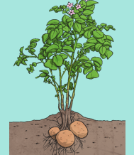
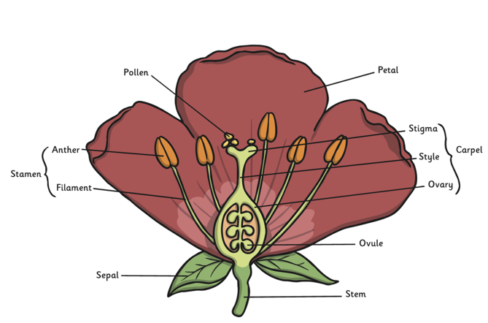
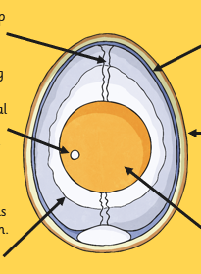
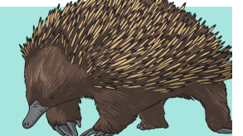
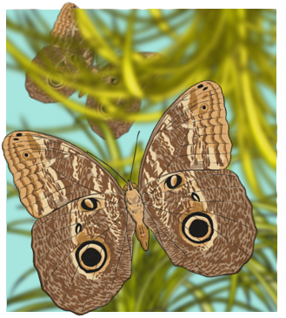
PHSE: Year 5/6 – Summer Term – Science : Knowledge Organiser
UKS2 Lesson 1 – describe how plants reproduce.
Key vocabulary - Sexual, asexual, reproduction, gamete, cell, pollen, ovule, fusion, fertilisation, pollination.
UKS2 Lesson 2 - describe how some plants reproduce.
Key vocabulary - asexual, reproduction, cuttings, roots
UKS2 Lesson 5 – explain the lifecycle of a bird
Key vocabulary - egg, yolk, albumen, embryo, bird, life cycle, reproduce
UKS2 Lesson 4 – compare the lifecycles of amphibians and insects
Key vocabulary - metamorphosis, amphibian, insect, transform, larvae, pupa, nymph, egg
UKS2 Lesson 6 - I can compare the life cycles of plants, mammals, amphibians, insects and birds
Key vocabulary – similar, different
UKS2 Lesson 3 – describe the life cycles of different mammals
Key vocabulary - sexual, reproduction, gamete, male, female, sperm, ovum, penis, vagina, fertilise, pregnancy, gestation, montreme, marsupial, young

