Slide 1
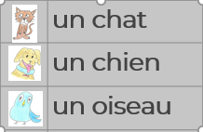
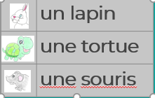
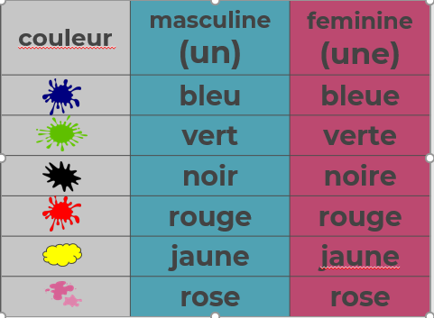
Qu’est-ce que c’est ?
Lesson 1 – I can Say the name of six pets.
Lesson 4 - I can describe pets using some more colours and using the conjunction ‘et’
Knowledge Organiser – KS2 Summer 1 2023
Lesson 2 - I can say that it is or isn’t a certain pet.
Ce n’est pas…….
C’est…….
Lesson 3 – I can describe the pets with some colours
C’est de quelle couleur?
Bleu, vert, noir
Lesson 5 - I can create a strange animal and describe them.
?

