Slide 1


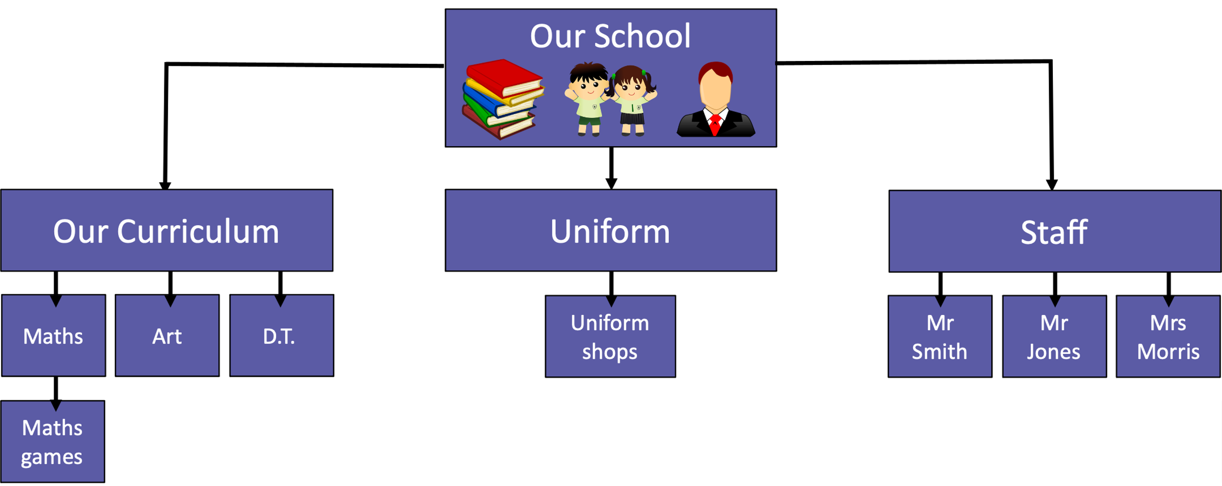
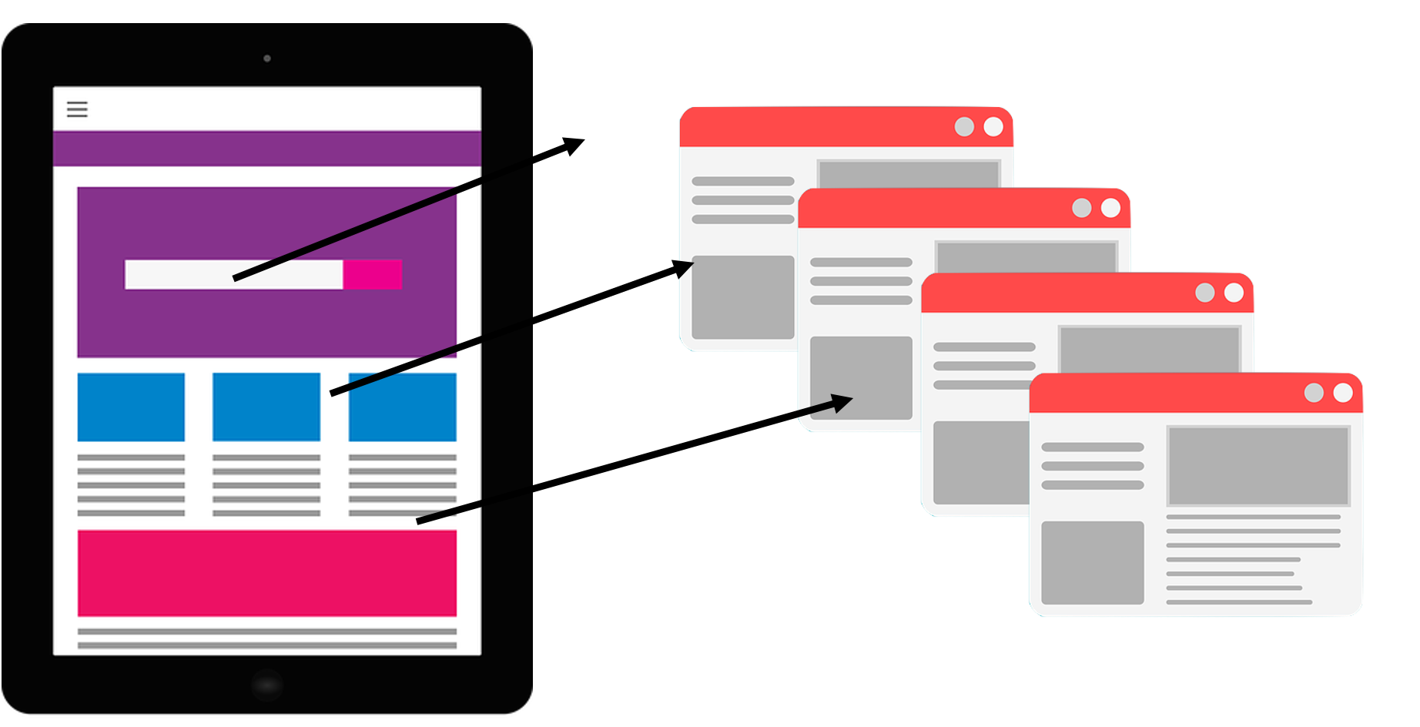

Creating media - Video production
New Knowledge
I know HTML is how websites are written and that websites have different types of media on them.
I know web pages have different features such as headers and can draw a layout for this.
I know that copyright is where someone own that piece of work and that I should use copyright free images.
I know I web pages are previewed to check for any mistakes and to make sure they work and can evaluate my own webpage.
I know what a navigation path is and can use hyperlinks to create my own navigation path between web pages.
Sticky learning
I know what WWW. stands for.
I know websites are shared via www. and the type of media that is stored on the www. (e.g. videos, websites and images)
I know anyone can add content to the internet and this means it is not always accurate.

Slide 2
Key Vocabulary
Hypertext Markup Language (HTML) | HTML is like the secret code that tells a computer how to show words, pictures, and colours on a webpage.
Browser | A browser is a special program (like Chrome or Safari) that lets you visit websites and explore the internet.
Header | A header is the top part of a webpage or a document that usually has a title or important information.
Website | A website is like a digital book or a house on the internet, filled with different pages you can visit.
Web page | A document on the World Wide Web
Copyright | Copyright means that someone owns their work (like a story, picture, or song), and others can’t use it without permission.
Fair Use | Fair use means that sometimes, small parts of copyrighted work can be used for things like school projects, news, or teaching, but only in the right way.
Home Page | The home page is the main page of a website, like the front door to a house, where you start exploring.
Preview | A preview is a sneak peek of something before it is finished, like watching a short part of a movie before seeing the whole thing.
Hyperlink | A hyperlink is a special word, picture, or button on a website that you can click to jump to another page.
Subpage | A subpage is a smaller page inside a website, like a chapter in a book, that gives more information about something.

